Slide 1
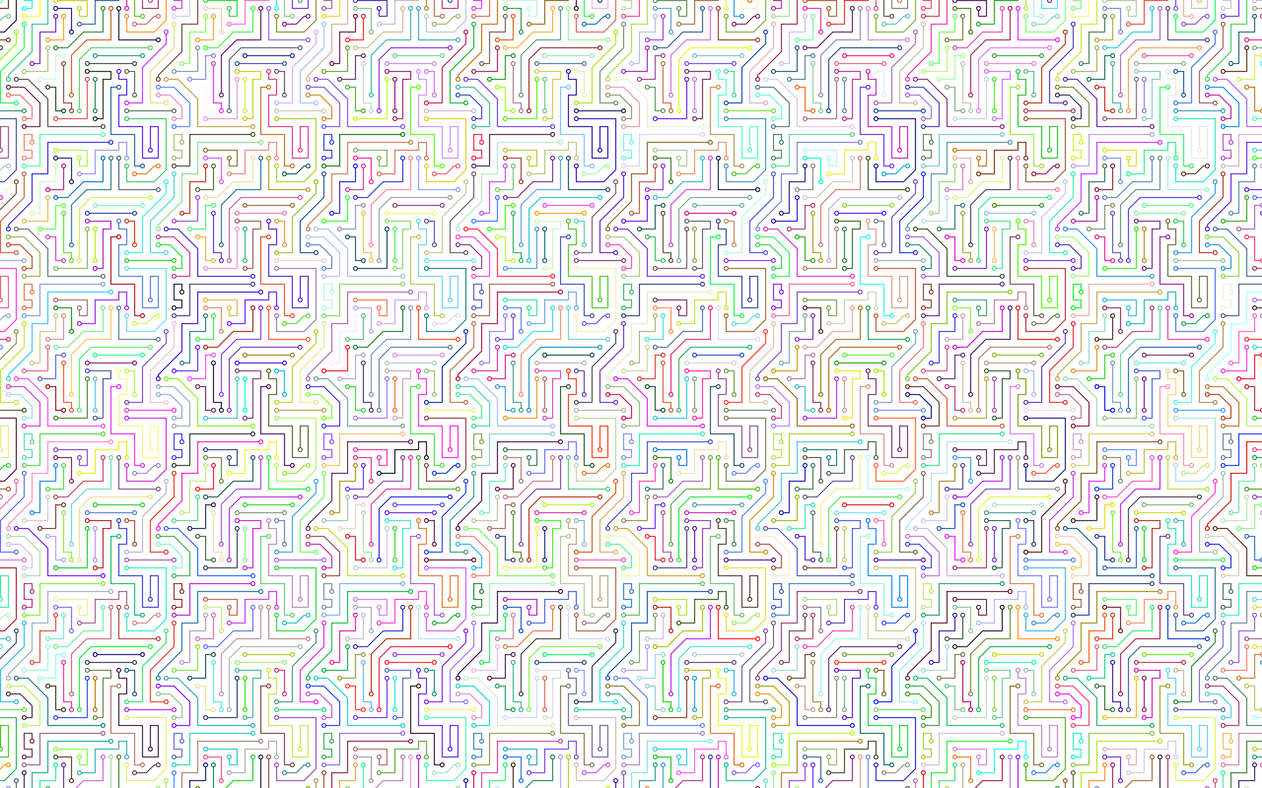
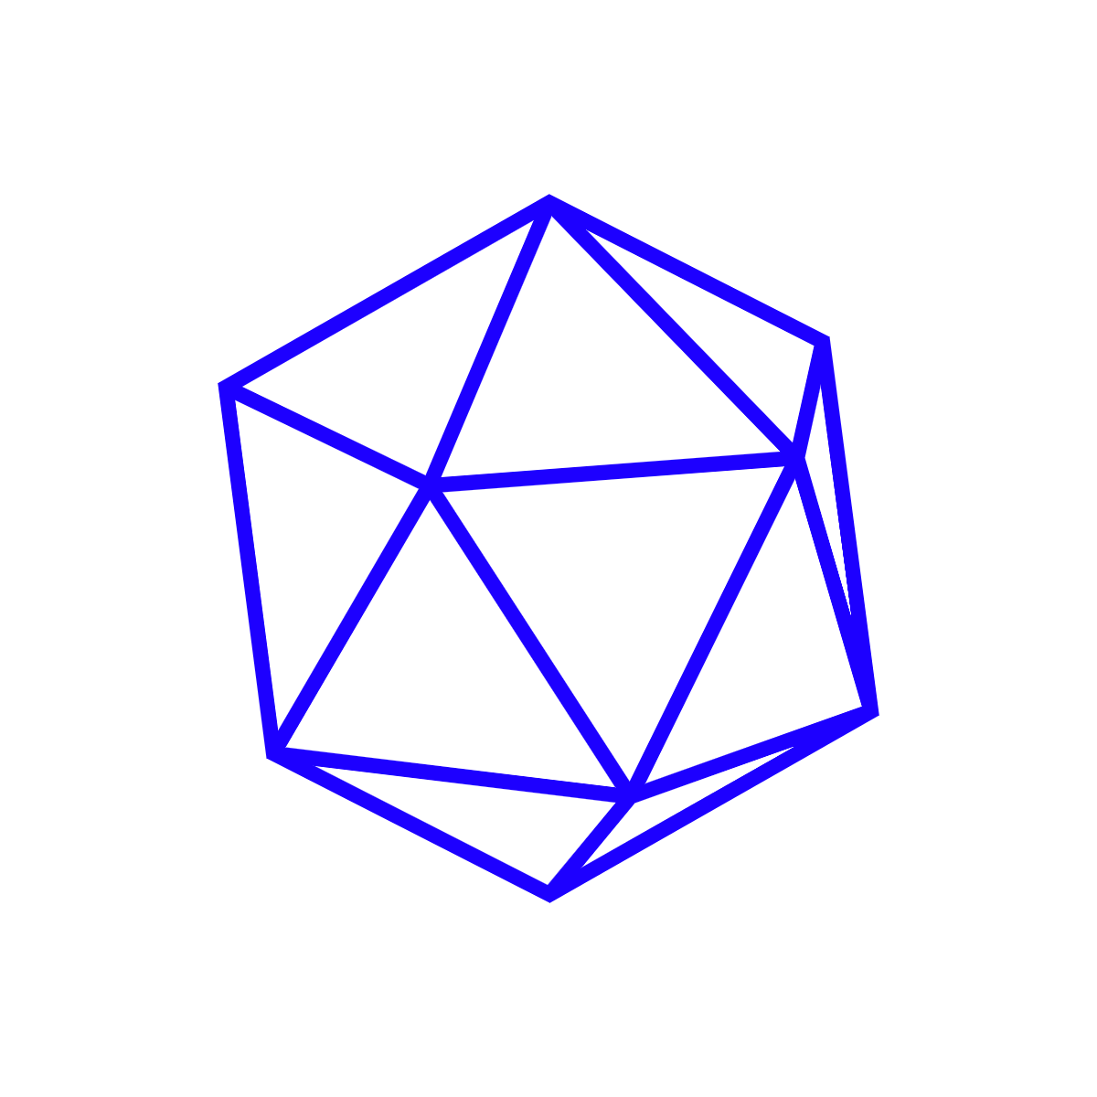

Object Pascal Foundation
Draft Proposal | 2024-04-21
Jim McKeeth | jim@mckeeth.org

Slide 2
Disclaimer
This is a draft proposal and does not necessarily represent the opinions or plans of any other individual or organization that may or may not have contributed or commented on this proposal
As this is an early draft proposal, it is subject to change as the conversation evolves
Expressing interest in the foundation doesn't indicate endorsement

Slide 3

Outline/Overview
Propositions
Goals & Non-Goals
Competition
Naming
Potential Members
Outcomes & Objectives
Why the Icosahedron?
Next Steps…
This is less of a presentation, and more of an outline organized on slides.
Feel free to comment (request access if you are unable to comment.)

Slide 4
Resources
Share these slides
Website coming soon
objectpascal.foundation
github.com/ObjectPascalFoundation/
Sign-up for more information
List of respondents

Slide 5
Basic Ideas/Propositions
Object Pascal, in its various flavors/dialects/implementations, is a powerful, modern, and useful language
Object Pascal is a family of languages with different names and features
Object Pascal is bigger than any one of the organizations involved
Most developers use more than one development tool; either within a single project or across multiple projects
There is value in developers having access to multiple Object Pascal tools
Within the larger developer community more can be done to promote Object Pascal as a whole (common syntax highlighting, tutorials, etc.)
Collaboration is a good thing - when we work together we each reach further
Promoting the good in each is better than emphasizing the bad in the others

Slide 6
Goals
Show Object Pascal is alive, modern, useful, and evolving
Answer “Why Object Pascal?” with a hurrah instead of an apology
Promote all Object Pascal implementations
For development, education, research, etc.
Expand acceptance and support of Object Pascal in tools and online
Collaborate for the future of Object Pascal
Create a consolidated directory of Object Pascal related & supporting tools
Promote each implementation/tool without the need to attack or denigrate
Focus on individual strengths and features
Promote interoperability and compatibility where it exists
Embrace and celebrate the future of Object Pascal

Slide 7
Not a “Standard” and Not a “Regulation”
These are non-goals and things specifically avoided
Not creating a “standard” that implementations should follow
This isn’t about taking autonomy away. Anyone can implement Object Pascal with the language features they want. How implementers choose to be compatible is up to them.
No regulating how or what anyone calls their implementation
If some decides their Object Pascal based language is now called Steve and isn’t Object Pascal that is their choice.
Likewise if someone makes a language that looks like C, but they want to say it is Object Pascal based/influenced that is fine too.
Not restrict the behaviors or actions of members
We do ask that foundation members not denigrate other implementations, but the foundation does not restrict or censure member actions.

Slide 8
Formalized Definition of Interoperability
The “don’t call it a standard” standard - but maybe eventually call it a standard if everyone agrees.
Languages should be slow to add features since they are hard to remove once developers are using them
Delphi and Object Pascal have a strong focus on backward compatibility.
Formalize the superset of language syntax and features used by all implementations
Select what everyone agrees on as the “definition”
Conversations can take place on how to improve compatibility and interoperability, and how to move the language forward
Potentially two definitions: One for scripting OP implementations and one for non-scripting implementations

Slide 9
Which is the Best Object Pascal?
This is an irrelevant question
Each implementor has different goals and can believe and state theirs is the best at reaching their goals
There are obvious overlaps in goals. There is nothing wrong with saying: “we believe we are the best or better because we do the following …..”
Focusing on your strengths is better than saying “we are better because the other implementations are bad.”
If you are only better by comparison with something that is bad, then you aren’t very good
McDonalds and Burger King never criticize hamburgers

Slide 10

But Competition!?!
Programming languages and tools is not a zero sum game
One does not have to lose for another to win
A developer is more likely to choose Object Pascal if they see multiple options/vendors supporting them
Apple, Google, Microsoft, and Samsung all compete, and work together
Competition is a good thing - this isn’t about price fixing or other anti-competitive practices
McDonalds and Burger King never criticize burgers

Slide 11
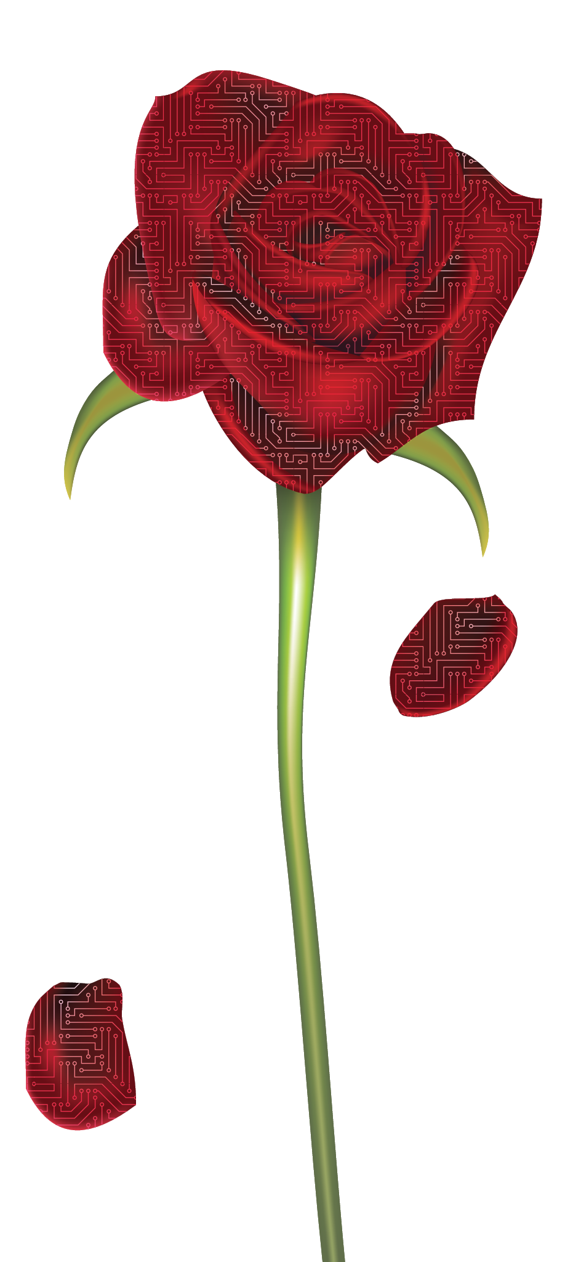
Object Pascal vs. Pascal
Object Pascal is the evolution of Pascal
Object Pascal is a family of implementations and dialects
The preference for naming is Object Pascal (or OP), but dialects and implementations are welcome to use other names
Component Pascal, Modula, Oberon, etc. may also belong (if implementers want to….)
What's in a name? That which we call Object Pascal by any other name would be as neat!

Slide 12
Potential Member Organizations/Implementations
Blaise Pascal
DWScript
Elevate Web Builder
Embarcadero’s Delphi
Fast Report’s Fast Script
Free Pascal
GNU Pascal
Lazarus
ModernPascal
RemObjects’ Oxygene & PascalScript
Smart Mobile Studio
TMS WebCore
Utilibo
Other Object Pascal Scripting implementations
Other Object Pascal Compilers

Slide 13




Outcomes
Website promoting Object Pascal and the Foundation
Answer “Why Object Pascal?” with a hurrah and not an apology
References on interoperability and compatibility
Promote Object Pascal inclusion in other tools and directories
Promote Object Pascal in Education, Industry, and Hobby
Directory of members and their products
Directory of tools supporting Object Pascal
Directory of clubs and community groups
Directory of books and resources

Slide 14
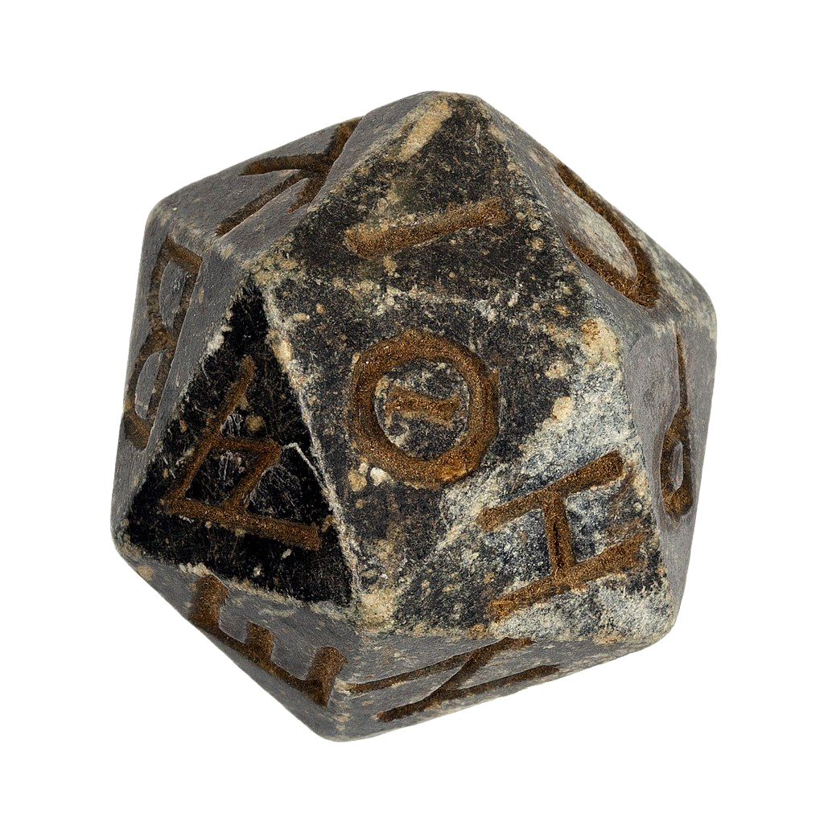
Why the Icosahedron
The regular icosahedron has 20 faces, 30 edges and 12 vertices
It is one of the five Platonic solids, and the one with the most sides
4-Tetrahedron, 6-Cube, 8-Octahedron, 10-Dodecahedron, 20-Icosahedron
Blaise Pascal is known for Pascal’s Triangle, and the icosahedron is made up of triangular faces
Blaise Pascal contributed to probability theory, and since ancient times the icosahedron has been used as a twenty sided dice
Just as an icosahedron has many sides, so does the Object Pascal Foundation
All the sides of the icosahedron work together as one
Pascal’s Triangle - a triangular array of the binomial coefficients
Twenty-sided die from Ptolemaic Egypt

Slide 15

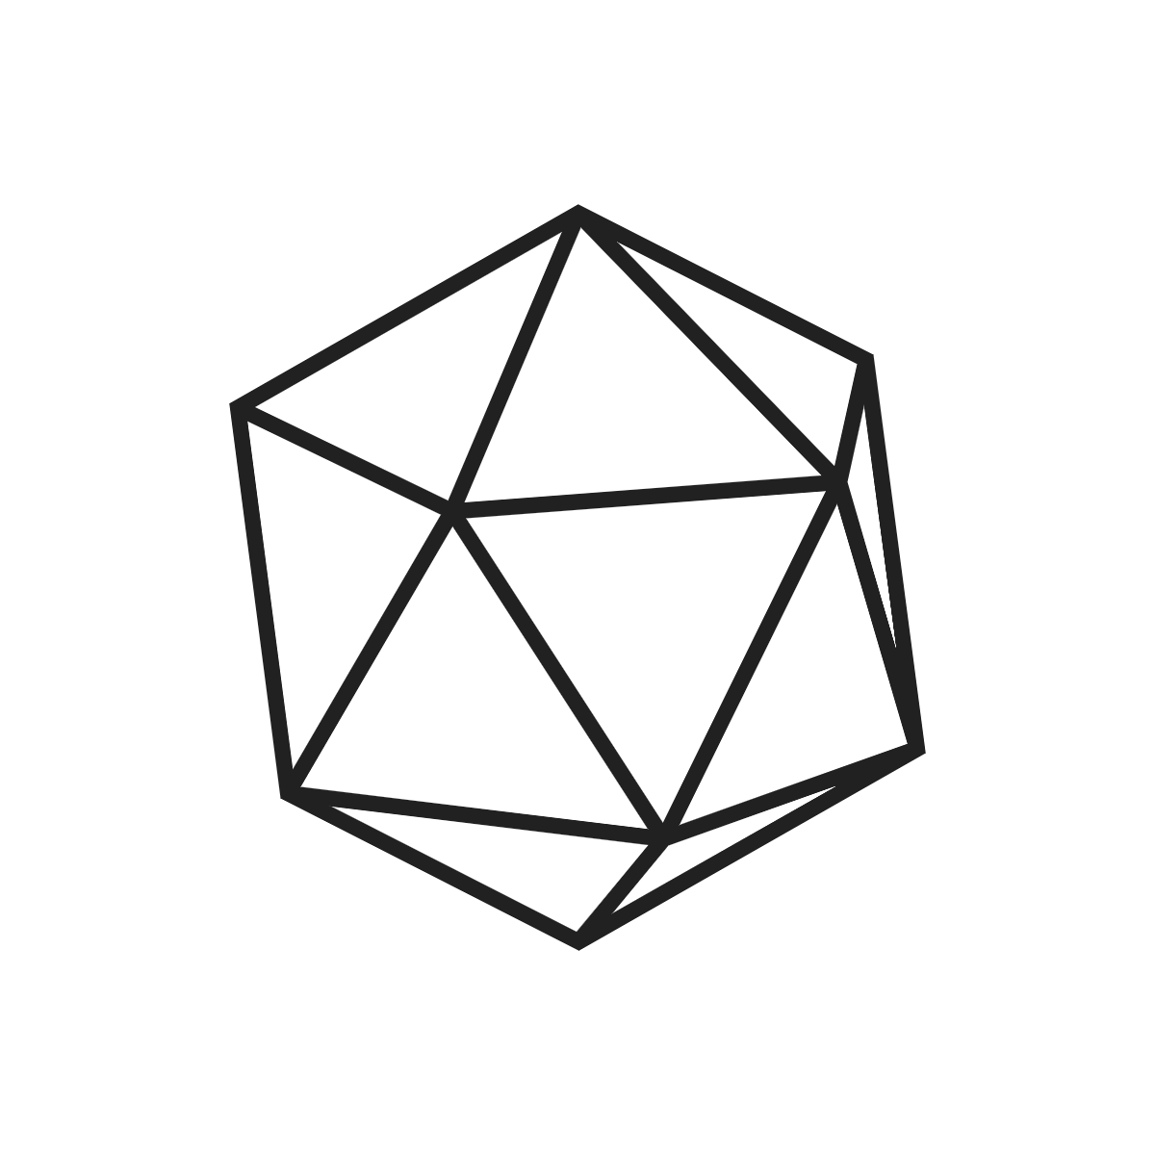
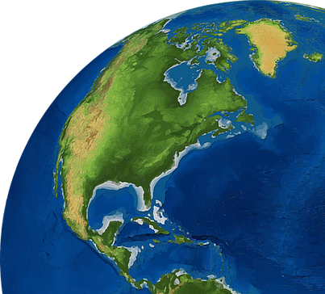
Next Steps
Identify and invite additional potential members
Setup Website
Meet to discuss
Work out organizational details
Collect resources and populate directories
Promote Object Pascal
???
Profit?
World domination?

Slide 16
Object Pascal
Foundation

